Slide 1
Reading Comprehension Techniques
Department of Computer Sciences
By
Fouzia Jamal Goreja

Slide 2
INTRODUCTION
Reading is an active process that involves recognizing meaning of words, leading to the development of comprehension.
University students read materials :
for a range of purposes,
written in a range of styles,
taken from a range of sources
Reading with a purpose helps the reader to direct information towards a goal and focuses their attention.
Notes:
EYE BRAIN

Slide 3
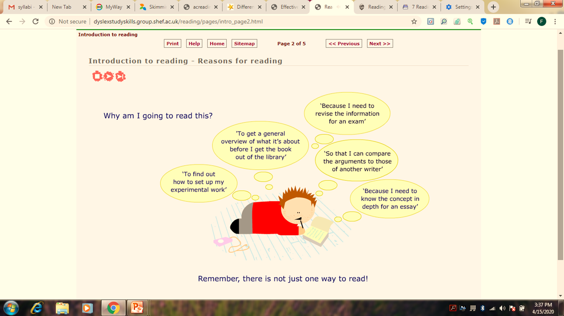
REASONS OF READING

Slide 4
Comprehension strategies
Comprehension strategies are conscious plans — sets of steps that good readers use to make sense of text. These strategies help students to become purposeful and active readers.
Steps of Reading Comprehension:
Pre reading (Preview/take a glance)
While reading (at this stage, apply most of the reading techniques)
Post reading (writing or taking notes for keeping record)

Slide 5
ORIENTATION
(Pre reading preparation)
Look carefully at anything that can give you information on the reading:
For example: table of contents, the introduction to the story, the title, subheadings within the story, visuals, flow charts etc.

Slide 6
SKIMMING
To get the general meaning (gist) of the story without trying to decode exactly what each word means.
Read the whole text through silently twice:
First reading: Focus on what make sense and leave what you cannot understand
Second reading: will give you a much better feeling for the content.
Notes:
Reading topic/introductory sentences

Slide 7
Cont..
This reading technique is used for getting the gist of the whole text read.
Example:
We generally use this technique at the time of reading a newspaper or magazine.

Slide 8
SCANNING
Scanning through the text is a reading strategy that is used to extract specific pieces of information by looking at the whole text.
Examples:
scan a train schedule for information,
a travel brochure for different information,
a theater program for a another type.
and looking up a name from the telephone guidebook.

Slide 9
scanning techniques
Vocabulary: proper nouns, dates, numbers, and times are most important when scanning
Circling, underlining or highlighting all of the key words
There are now over 700 million motor vehicles in the world - and the number is rising by more than 40 million each year. The average distance driven by car users is growing too - from 8 km a day per person in western Europe in 1965 to 25 km a day in 1995. This dependence on motor vehicles has given rise to major problems, including 1)environmental pollution, 2)depletion of oil resources, 3)traffic congestion and safety.
Notes:
Capital letters

